Slide 1

Quality of Airbus Type Airplanes

Slide 2
Executive Summary
Problem:
Solution:
Recommendation:
To determine which type of airplane has the best and which has the worst fatalities
We have analyzed and identified which type of airplane have the most fatalities
We can decommission the planes with more fatalities from service immediately.

Slide 3
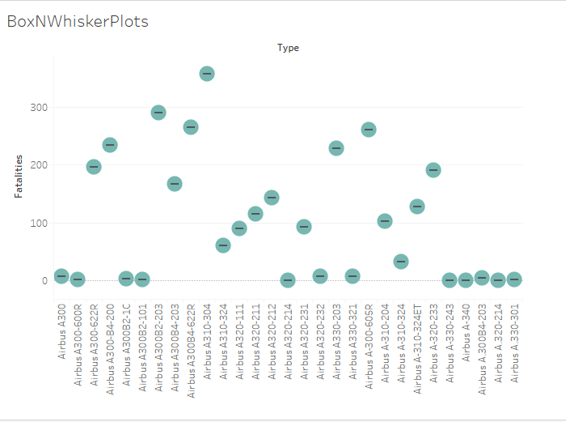
Type of Plane Vs Fatalities

Slide 4
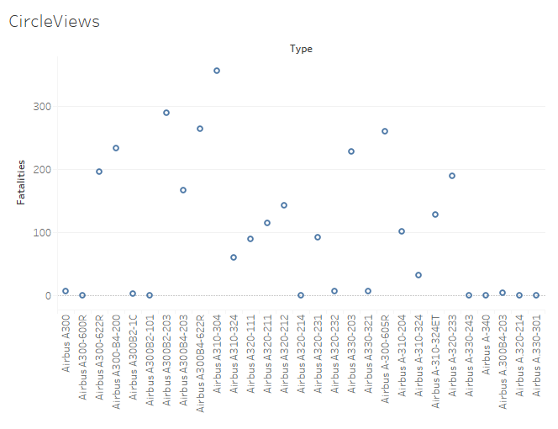
Type of Plane Vs Fatalities

Slide 5
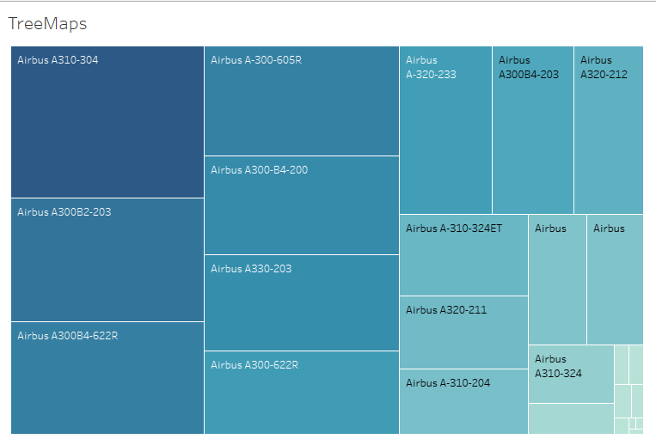
Type of Plane Vs Fatalities

Slide 6
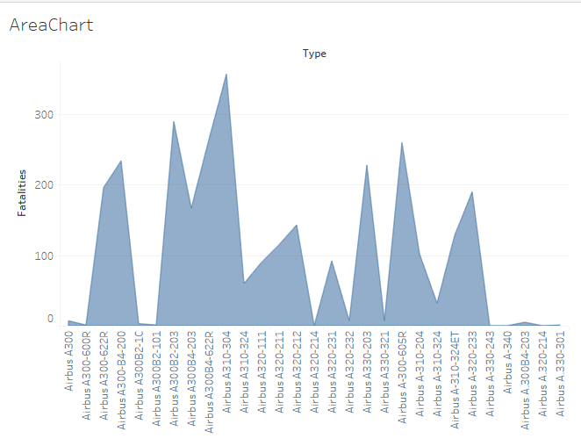
Type of Plane Vs Fatalities

Slide 7
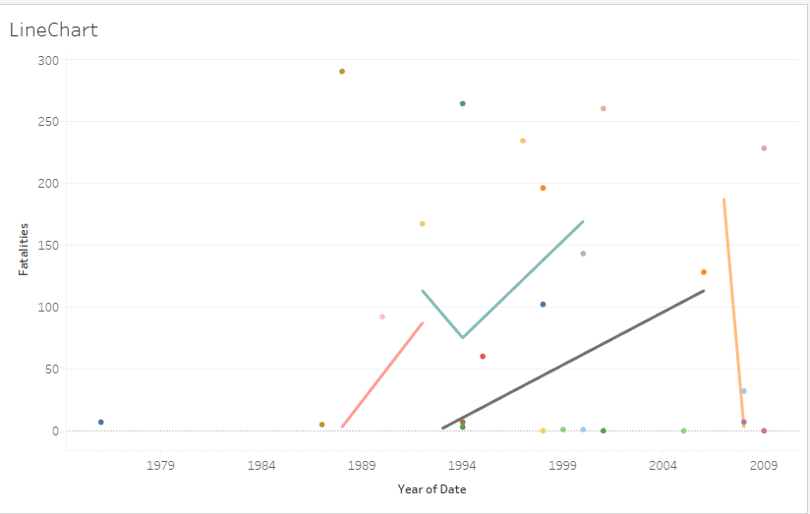
Type of Plane Vs Fatalities

Slide 8
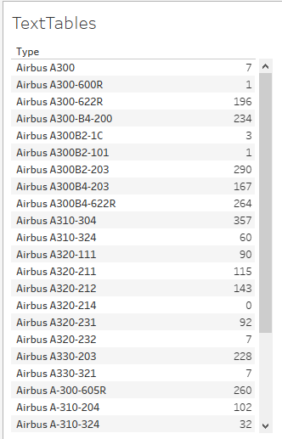

Type of Plane Vs Fatalities

Slide 9
Conclusion
Problem:
Recommendation Result:
Safety concerns threaten the reputation of Airways due a growing trend of fatalities.
We can recommend to decommission the models of the airplanes where the fatalities rate is more.

